Slide 1





Supervised & Unsupervised Encoding Methods of Categorical Variables for Prediction Performance Enhancement
By Yun-Hao Yang
Notes:
國科會、台大
主標 - 全名
副標 - 姓名

Slide 2

Overview
Motivation
Introduction
Methodology
Case study
Conclusion
Notes:
Not needed

Slide 3
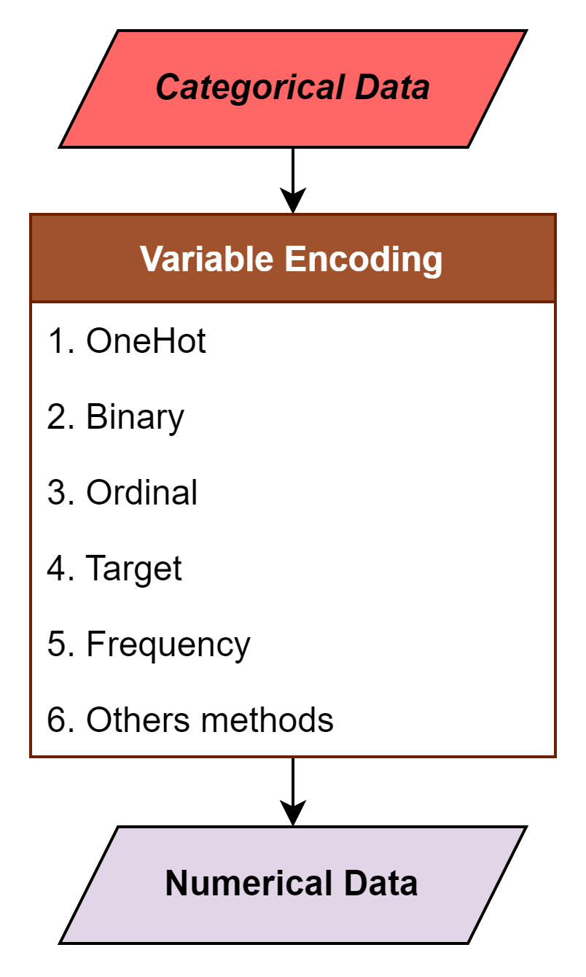
Motivation
Shape
■
▲
●
Variable encoding is need for transforming the categorical data. Many encoding method had been invented to fulfill such task. Among all, One hot encoding is the one of the most commonly used method.
ENCODER
■ | ▲ | ●
0 | 0 | 1
0 | 1 | 0
1 | 0 | 0
Notes:
Abstract ➔ motivation
字少 圖多 only for 解釋
新舊資料比較
Motivation 畫餅解釋

Slide 4
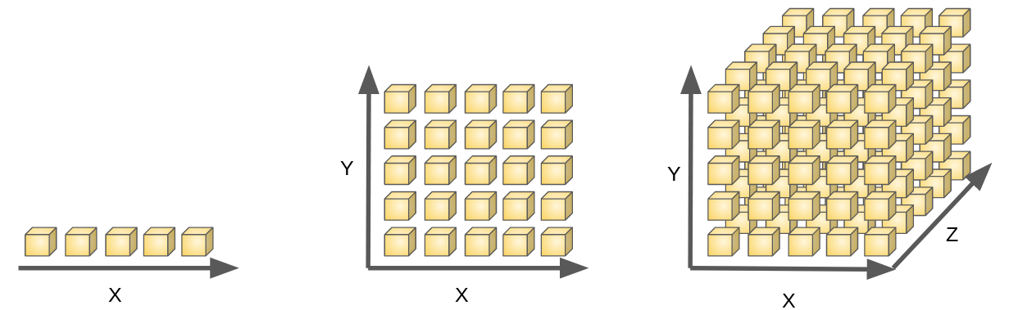
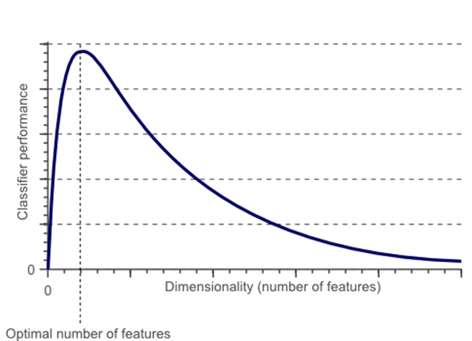
Motivation
Categorical | Animal
 | Cow
 | Tuna
 | ⁝
 | Frog
One Hot
Binary | Animal
 | Tuna | Cat | Frog | Cod | Goat | Dog | … | Cow
 | 0 | 0 | 0 | 0 | 0 | 0 |  | 1
 | 1 | 0 | 0 | 0 | 0 | 0 |  | 0
 | ⁝ | ⁝ | ⁝ | ⁝ | ⁝ | ⁝ |  | ⁝
 | 0 | 0 | 1 | 0 | 0 | 0 |  | 1
Notes:
Luckily if the data follow the strict format of One Hot encoding, we might reverse it back to the categorical data and use other encoding methods (such as target, ordinal encode) to generate the numerical data. Yet, If the data violate the rule of it, what can we do to down size the features? While advoid the numerous 0? While looking into One Hot encoded data, We can easily see multiple features, in which rare 1 surrounded by numerous 0. However, It’s not very preferable for the machine learning model, for the following 2 reasons
Too many features yield the curse of dimensionality.
Numerous 0 can’t calculate the gradient, makes most ML boosting algorithm invalid.

Slide 5
Motivation
Categorical | Animal | Size | Color
 | Cow | Big | White
 | Tuna | Med | Black
 | ⁝ | ⁝ | ⁝
 | Frog | Tiny | Green
Other Encoding
Numerical | Animal | Size | Color
 | 10 | 4 | 7
 | 2 | 3 | 6
 | ⁝ | ⁝ | ⁝
 | 7 | 1 | 3
One Hot
Binary | Animal |  |  |  |  |  |  |  | Size |  |  |  | Color
 | Tuna | Cat | Frog | Cod | Goat | Dog | Toad | Cow | Large | Mid | Small | Tiny | White | Black | Red | Blue | Green | Gray
 | 0 | 0 | 0 | 0 | 0 | 0 | 0 | 1 | 1 | 0 | 0 | 0 | 1 | 0 | 0 | 0 | 0 | 0
 | 1 | 0 | 0 | 0 | 0 | 0 | 0 | 0 | 0 | 1 | 0 | 0 | 0 | 1 | 0 | 0 | 0 | 0
 | ⁝ | ⁝ | ⁝ | ⁝ | ⁝ | ⁝ | ⁝ | ⁝ | ⁝ | ⁝ | ⁝ | ⁝ | ⁝ | ⁝ | ⁝ | ⁝ | ⁝ | ⁝
 | 0 | 0 | 1 | 0 | 0 | 0 | 0 | 1 | 0 | 0 | 0 | 1 | 0 | 0 | 0 | 0 | 1 | 0
Notes:
In machine learning, we often stumble upon datasets contains with multiple categorical features. To let the computer understand those categorical data, variable encoding is needed, which helps transform the data.
Until today, many encoding methods had been created for this such circumstances
Among all methods, One Hot encoding is the most commonly used for such scenario for its convenience and efficiency, By creating mutually exclusive dummy variable for each category in each categorical feature.
Yet many problems might come along with it…

Slide 6


Motivation
Numerical | Group 1 | Group 2 | Group 3
 | 10 | 4 | 7
 | 2 | 3 | 6
 | ⁝ | ⁝ | ⁝
 | 7 | 1 | 3
When the data is not follow the One Hot rule, can’t use other method to transform the binary data. If only can we find a way in representing the numerous binary features data in a much simple way...
Binary | Tuna | Cat | Frog | Cod | Goat | Dog | Toad | Cow | Large | Mid | Small | Tiny | White | Black | Red | Blue | Green | Gray
 | 0 | 0 | 0 | 0 | 0 | 0 | 0 | 1 | 1 | 0 | 0 | 0 | 1 | 0 | 0 | 0 | 0 | 0
 | 1 | 0 | 0 | 0 | 0 | 0 | 0 | 0 | 0 | 1 | 0 | 0 | 0 | 1 | 0 | 0 | 0 | 0
 | ⁝ | ⁝ | ⁝ | ⁝ | ⁝ | ⁝ | ⁝ | ⁝ | ⁝ | ⁝ | ⁝ | ⁝ | ⁝ | ⁝ | ⁝ | ⁝ | ⁝ | ⁝
 | 0 | 0 | 1 | 0 | 0 | 0 | 0 | 1 | 0 | 0 | 0 | 1 | 0 | 0 | 0 | 0 | 1 | 0
Notes:
In machine learning, we often stumble upon datasets contains with multiple categorical features. To let the computer understand those categorical data, variable encoding is needed, which helps transform the data.
Until today, many encoding methods had been created for this such circumstances
Among all methods, One Hot encoding is the most commonly used for such scenario for its convenience and efficiency, By creating mutually exclusive dummy variable for each category in each categorical feature.
Yet many problems might come along with it…

Slide 7
Introduction
Binary
Numerical
Notes:
To ease the sparsity and expanding dimension of the binary features data, we developed a method to handle and transform multiple binary features data back to numerical data. The main idea of improve of the following points
Compress the information of multiple binary features into same numerical features.
Ease sparsity and problem of calculating gradient on binary features.
Generate a neat, thinner numerical data for ML model

Slide 8
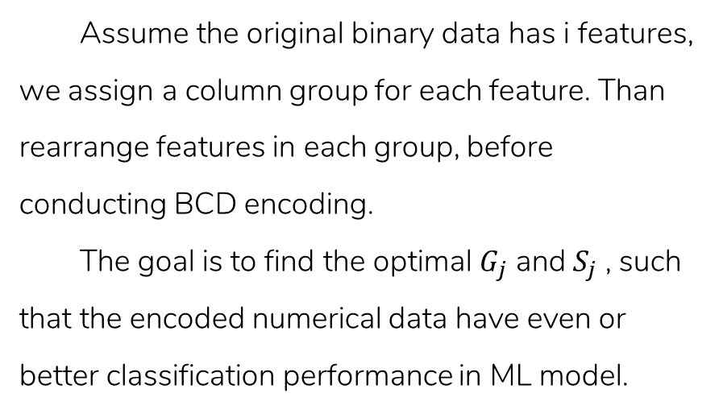
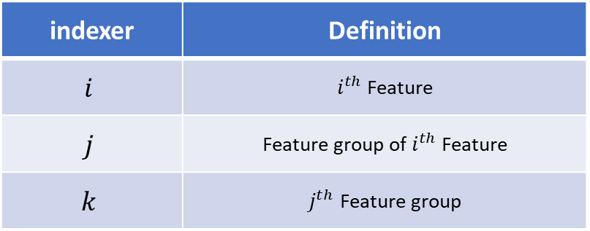
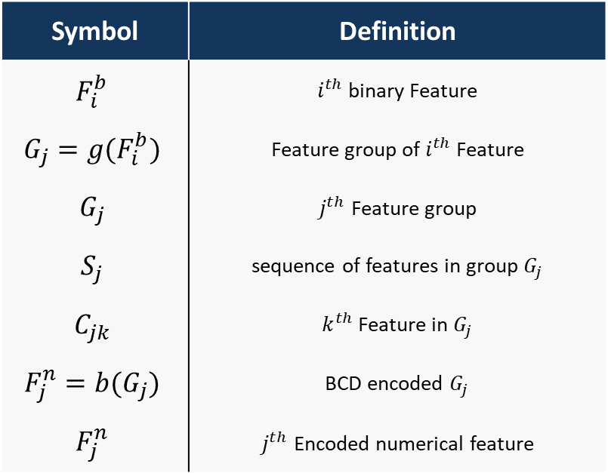
Introduction - cont.
Assume the original binary data has i features, we assign a column group for each feature. Than rearrange features in each group, before conducting BCD encoding.
The goal is to find the optimal $G_{j}$ and $S_{j}$ , such that the encoded numerical data have even or better classification performance in ML model.
Symbol | Definition
$$F_{i}^{b}$$ | $i^{th}$ binary Feature
$$G_{j}=g(F_{i}^{b})$$ | Feature group of $i^{th}$ Feature
$$G_{j}$$ | $j^{th}$ Feature group
$$S_{j}$$ | sequence of features in group $G_{j}$
$$C_{jk}$$ | $k^{th}$ Feature in $G_{j}$
$$F_{j}^{n}=b(G_{j})$$ | BCD encoded $G_{j}$
$$F_{j}^{n}$$ | $j^{th}$ Encoded numerical feature
indexer | Definition
$$i$$ | $i^{th}$ Feature
$$j$$ | Feature group of $i^{th}$ Feature
$$k$$ | $j^{th}$ Feature group
Notes:
可以先不要

Slide 9
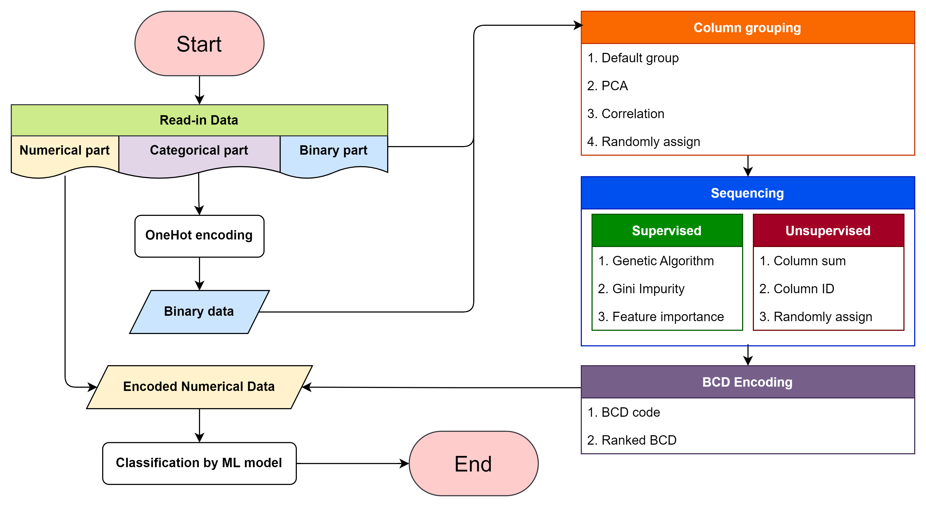
Methodology
Col 6 | Col 2 | Col 5 | Col 4 | Col 1 | Col 3
0 | 1 | 0 | 1 | 1 | 0
0 | 0 | 1 | 1 | 1 | 0
⁝ | ⁝ | ⁝ | ⁝ | ⁝ | ⁝
1 | 0 | 1 | 0 | 0 | 1
Notes:
拉開些
Numerical part ➔

Slide 10
Methodology
In the research, we propose a method to encode binary data in to numerical data. Via grouping, sequencing and transforming the binary row data with BCD encode.
Grouping similar, correlated features
Sequencing features in each feature group
BCD encode on each feature group
Toad | Cat | Frog | Cod | Tuna | Cow
1 | 1 | 0 | 1 | 0 | 0
1 | 0 | 0 | 1 | 1 | 0
⁝ | ⁝ | ⁝ | ⁝ | ⁝ | ⁝
0 | 0 | 1 | 0 | 1 | 1
Col 1 | Col 2 | Col 3 | Col 4 | Col 5 | Col 6
1 | 1 | 0 | 1 | 0 | 0
1 | 0 | 0 | 1 | 1 | 0
⁝ | ⁝ | ⁝ | ⁝ | ⁝ | ⁝
0 | 0 | 1 | 0 | 1 | 1

Slide 11
Methodology
In the research, we propose a method to encode binary data in to numerical data. Via grouping, sequencing and transforming the binary row data with BCD encode.
Grouping similar, correlated features
Sequencing features in each feature group
BCD encode on each feature group
Toad
1
1
⁝
0
Cat
1
0
⁝
0
Frog
0
0
⁝
1
Cod
1
1
⁝
0
Tuna
0
1
⁝
1
Cow
0
0
⁝
1

Slide 12
Methodology
In the research, we propose a method to encode binary data in to numerical data. Via grouping, sequencing and transforming the binary row data with BCD encode.
Grouping similar, correlated features
Sequencing features in each feature group
BCD encode on each feature group
Cat
1
0
⁝
0
Cow
0
0
⁝
1
Cod
1
1
⁝
0
Tuna
0
1
⁝
1
Toad
1
1
⁝
0
Frog
0
0
⁝
1

Slide 13
Methodology
In the research, we propose a method to encode binary data in to numerical data. Via grouping, sequencing and transforming the binary row data with BCD encode.
Grouping similar, correlated features
Sequencing features in each feature group
BCD encode on each feature group
Cow | Cat | Tuna | Cod | Toad | Frog
0 | 1 | 0 | 1 | 1 | 0
0 | 0 | 1 | 1 | 1 | 0
⁝ | ⁝ | ⁝ | ⁝ | ⁝ | ⁝
1 | 0 | 1 | 0 | 0 | 1

Slide 14
Methodology
In the research, we propose a method to encode binary data in to numerical data. Via grouping, sequencing and transforming the binary row data with BCD encode.
Grouping similar, correlated features
Sequencing features in each feature group
BCD encode on each feature group
Mammal | Fish | Amphibian
1 | 1 | 2
0 | 3 | 2
⁝ | ⁝ | ⁝
2 | 2 | 1

Slide 15
Methodology - Grouping
At first, we evaluate all binary features’ relation with each other, whether by correlation or PCA weights. Then group the relevant, or correlated features together.
Default group from categorical data
Principal components analysis
Correlation
Notes:
別用 case study 的圖
簡單範例
Excel
Grouping ➔ feature selection, 決定新資料維度

Slide 16
Methodology - Grouping

Slide 17
Methodology - Sequencing
Secondly, sequencing features in each group by columns’ attributes, For outputting better BCD values after encode.
Column sum
Gini impurity
Feature importance
GA sequencing
Notes:
Sequencing ➔ 區分出不同的 tpye

Slide 18
Methodology - Sequencing
Notes:
Sequencing ➔ 區分出不同的 tpye

Slide 19
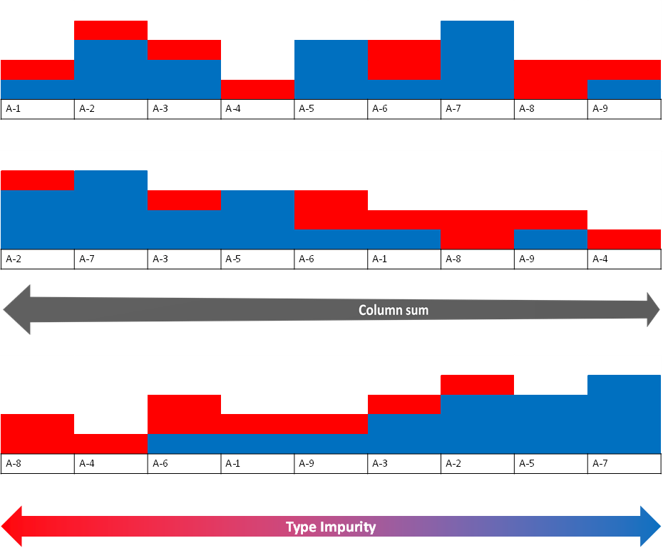
Methodology - Sequencing
Original
Column sum
Impurity
Notes:
Encode 完的比較

Slide 20
Methodology - BCD encode
Decimal digit | BCD
 | 8 | 4 | 2 | 1
0 | 0 | 0 | 0 | 0
1 | 0 | 0 | 0 | 1
2 | 0 | 0 | 1 | 0
3 | 0 | 0 | 1 | 1
4 | 0 | 1 | 0 | 0
5 | 0 | 1 | 0 | 1
6 | 0 | 1 | 1 | 0
7 | 0 | 1 | 1 | 1
8 | 1 | 0 | 0 | 0
9 | 1 | 0 | 0 | 1
BCD |  | Sorted Column Group |  |  |  |  |  |  | Type
 |  | Blue | Tuna | Tiny | Toad | Green | Cod
33 |  | 1 | 0 | 0 | 0 | 0 | 1 |  | Good
36 |  | 1 | 0 | 0 | 1 | 0 | 0 |  | Good
26 |  | 0 | 1 | 1 | 0 | 1 | 0 |  | Bad
14 |  | 0 | 0 | 1 | 1 | 1 | 0 |  | Bad
Notes:
At last, by using Binary-coded decimal technique, each grouped feature can be transform into numerical type. In the end, the new encoded data will have $j$ numerical features.

Slide 21
Methodology - BCD encode
Decimal digit | BCD
 | 8 | 4 | 2 | 1
0 | 0 | 0 | 0 | 0
1 | 0 | 0 | 0 | 1
2 | 0 | 0 | 1 | 0
3 | 0 | 0 | 1 | 1
4 | 0 | 1 | 0 | 0
5 | 0 | 1 | 0 | 1
6 | 0 | 1 | 1 | 0
7 | 0 | 1 | 1 | 1
8 | 1 | 0 | 0 | 0
9 | 1 | 0 | 0 | 1
Notes:
At last, by using Binary-coded decimal technique, each grouped feature can be transform into numerical type. In the end, the new encoded data will have $j$ numerical features.

Slide 22
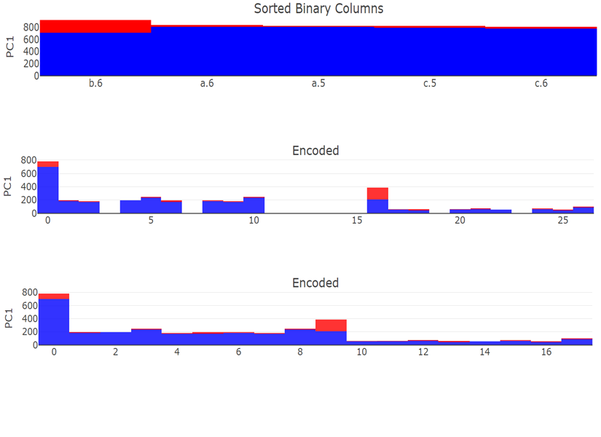
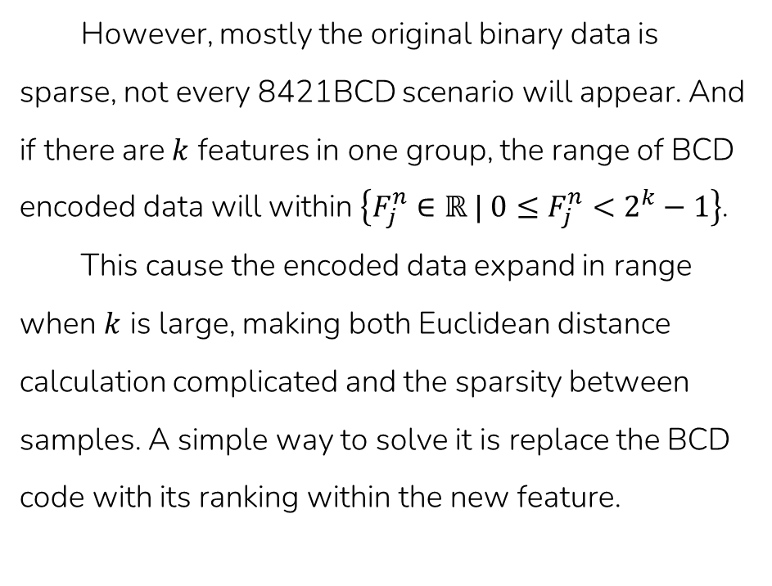
Methodology - BCD encode
However, mostly the original binary data is sparse, not every 8421BCD scenario will appear. And if there are $k$ features in one group, the range of BCD encoded data will within $\left\{F_{j}^{n}∈ℝ | 0≤F_{j}^{n}<2^{k}−1\right\}$.
This cause the encoded data expand in range when $k$ is large, making both Euclidean distance calculation complicated and the sparsity between samples. A simple way to solve it is replace the BCD code with its ranking within the new feature.
Sorted
BCD
Ranked
Notes:
別別別

Slide 23
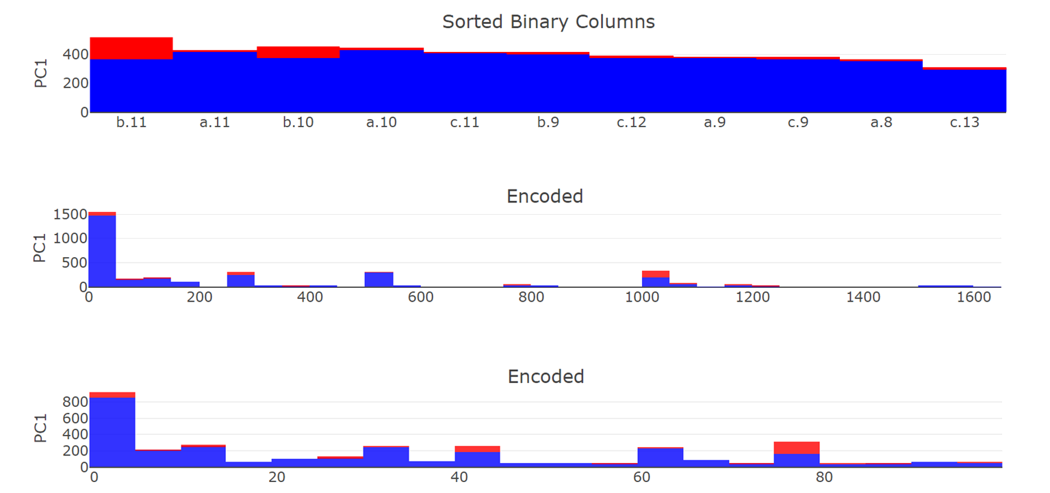
Methodology - BCD encode
Sorted
BCD
Ranked

Slide 24
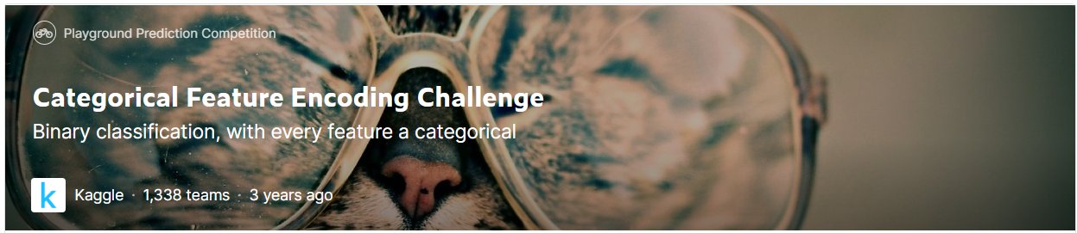
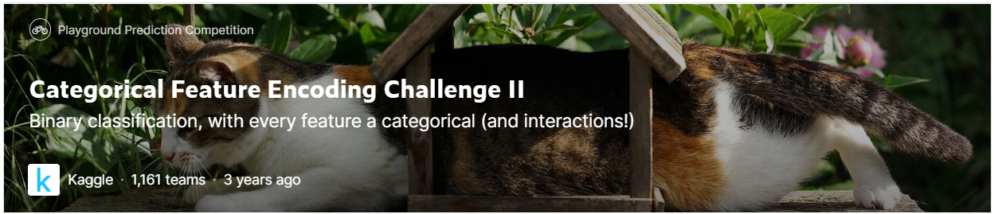
Case study
In Case study, we compare classification results with the commonly used variable encoding method under different datasets.
Generated continuous data
Kaggle dataset
Notes:
Only categorical feature encoding challenge

Slide 25
Case study - Continuous data

Slide 26
Case study - Kaggle dataset

Slide 27
Conclusion & Future work
In this research, we develop a method to encode binary feature data into numerical data, which can compress the binary features information to reduce dimension while remaining a certain level in ML model classification performance.
More over, after the experiments though multiple kinds of datasets, few interesting things was discovered
Default group form the categorical data often perform better than other feature selected group.
Sequencing grouped features effects on ML model performance.

